Slide 1
Pala Empire
SEM-II
CC-III
TAPASI MAITRA

Slide 2
Pala Empire 8th century–12th century

Slide 3
Origins
According to the Khalimpur copper plate inscription, the first Pala king Gopala was the son of a warrior named Vapyata.
Gopala was Kshatriya belonging to the legendary Solar dynasty.
The Ballala-Carita states that the Palas were Kshatriyas

Slide 4
Establishment
After the fall of Shashanka's kingdom, the Bengal region was in a state of anarchy.
The contemporary writings describe this situation as matsya nyaya
Gopala ascended the throne as the first Pala king during these times.
Gopala's ascension was a significant political event as the several independent chiefs recognised his political authority without any struggle.

Slide 5
Expansion under Dharmapala and Devapala
Gopala's empire was greatly expanded by his son Dharmapala and his grandson Devapala. Dharmapala was initially defeated by the Pratihara ruler Vatsaraja.
Later, the Rashtrakuta king Dhruva defeated both Dharmapala and Vatsaraja. After Dhruva left for the Deccan region, Dharmapala built a mighty empire in the northern India.
He defeated Indrayudha of Kannauj, and installed his own nominee Chakrayudha on the throne of Kannauj.

Slide 6
Revival under Mahipala I Second period of decline Revival under Ramapala
His reign is well-documented by Sandhyakar Nandi in Ramacharitam.

Slide 7
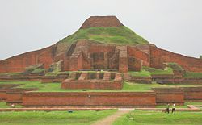
Culture Religion
The Palas were patrons of Mahayana Buddhism.
Dharmapala made the Buddhist philosopher Haribhadra his spiritual preceptor.
He established the Vikramashila monastery and the Somapura Mahavihara.
Paharpur Buddhist Bihar
পাহাড়পুর বৌদ্ধ বিহার

Slide 8
The ruins of Nalanda Mahavihara
The Palas developed the Buddhist centres of learnings, such as the Vikramashila and the Nalanda universities.

Slide 9
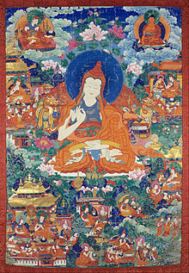
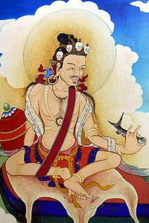
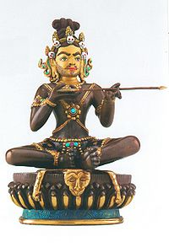
Noted Buddhist scholars from the Pala period include Atisha, Santaraksita, Saraha, Tilopa,

Slide 10
Literature
Charyapada
The Palas patronised several Sanskrit scholars,
Jimutavahana, Sandhyakar Nandi, Madhava-kara, Suresvara and Chakrapani Datta are some of the other notable scholars from the Pala period.

Slide 11
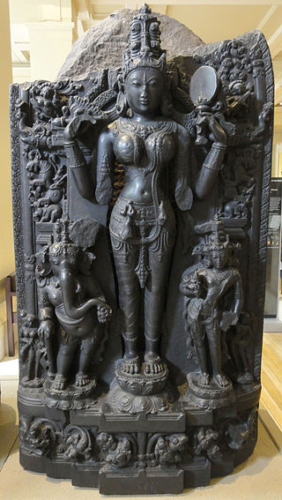
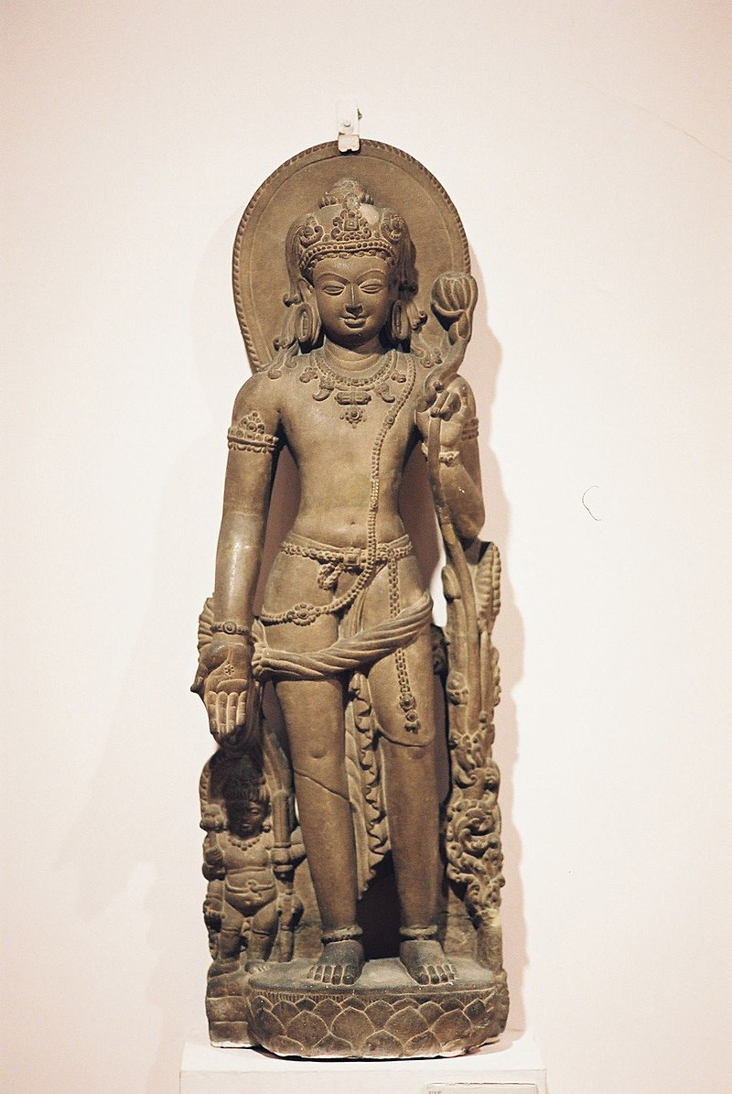
Art and architecture

Slide 12
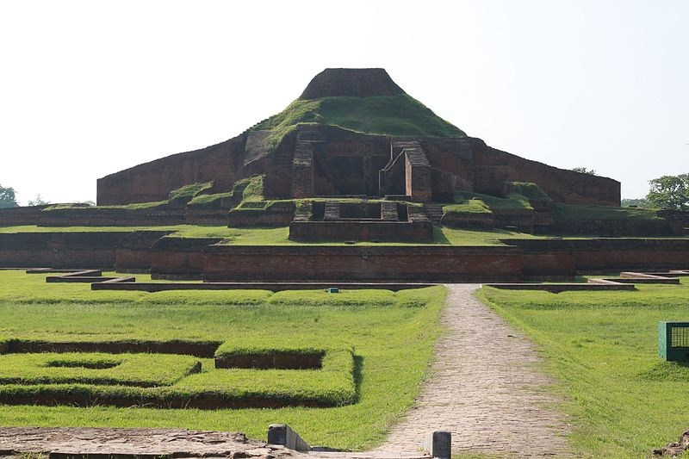
Somapura Mahavihara, a World Heritage Site, was built by Dharmapala

Slide 13
Central shrine decor at Somapura

Slide 14
Ruins of Vikramashila

Slide 15
THANKS

